Slide 1
High-throughput experiments elucidate the impact of multicomponent interactions on solute transport in complex feed streams.
Target Journal: Nature Water
Laurianne Estrada, Jonathan A. Ouimet, Zhicheng Lu, Molly Dougher, Shammah Lilonfe, Alexander Dowling, William Phillip
Experimental Results - 5/11/2024

Slide 2
Overarching Questions/Goals for Today
Reminder to experiments available.
What data is being collected throughout the course of these experiments?
How is this data analyzed to constrain the conductivity readings and monitor the concentration of ions in the feed and permeate?
Modeling efforts
Single component – Planning/discussion/timeline
Multicomponent systems
Concentration polarization
Solute Transport in membranes with Donnan
Experiments will focus on Na⁺ | Ca²⁺ | La³⁺ separations due to there importance in refining ores and recycling electronics.

Slide 3
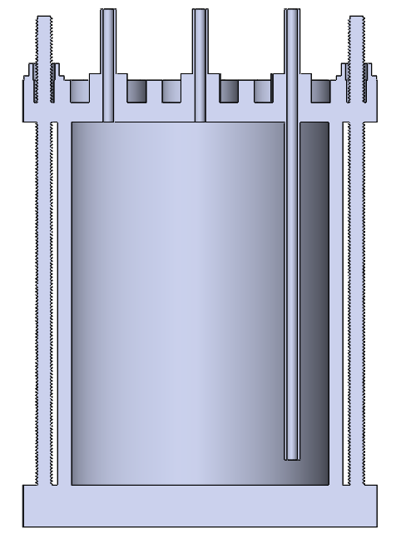
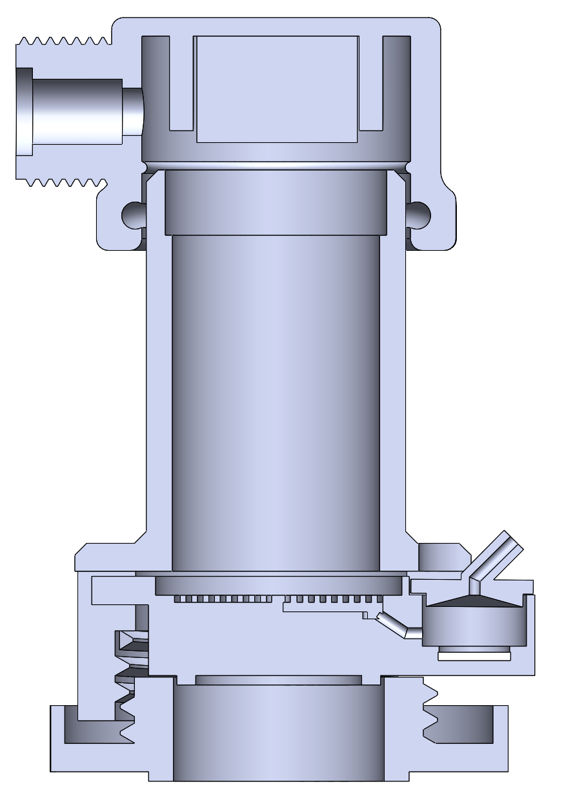
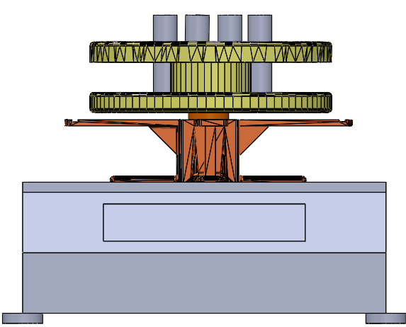

Diafiltration Experiments are Run in a Modified Stirred Cell Apparatus.
Pressure Relief Valve
P
Pressure Gauge
Stirred Cell
Scintillation Vials
Diafiltrate Tank
Permeate Outlet
Motor
Retentate Probe
Balance
Membrane
Permeate Probe
Multiple (two) salts are now placed within the feed and diafiltrate reservoirs.
Retentate and permeate conductivity data are obtained at 5 second intervals.
Scintillation vials are analyzed after the experiment (ICP-OES) to get ion specific concentrations.

Slide 4
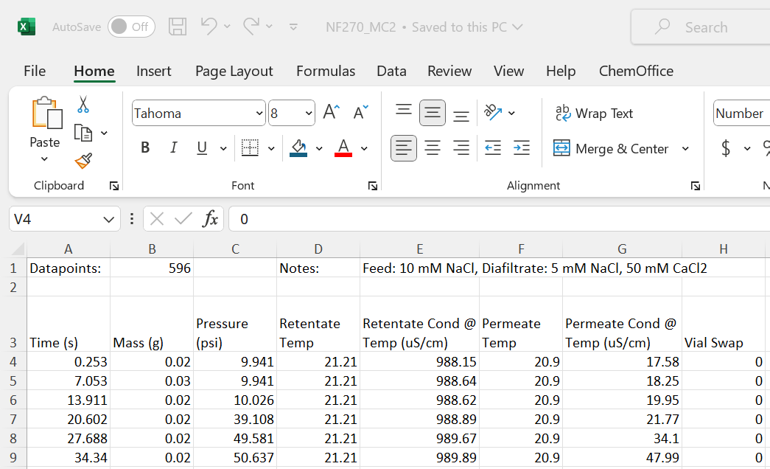
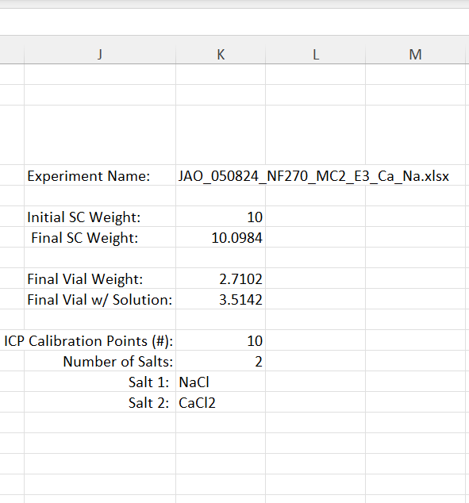
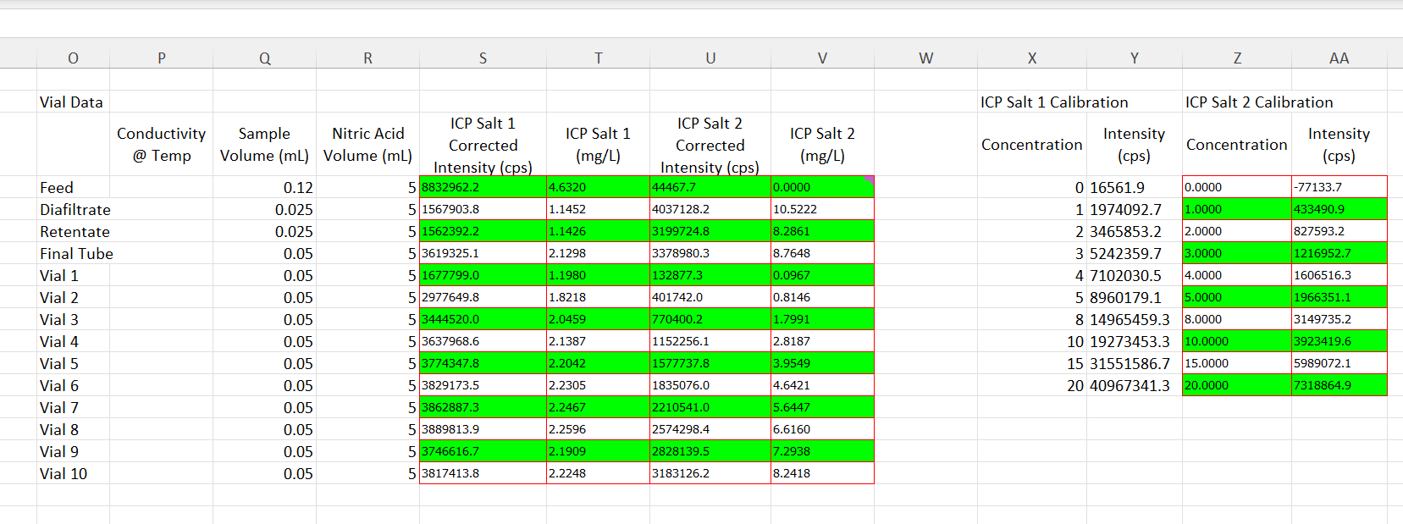
RAW Excel Data will be Included in the Supplementary Information.

Slide 5
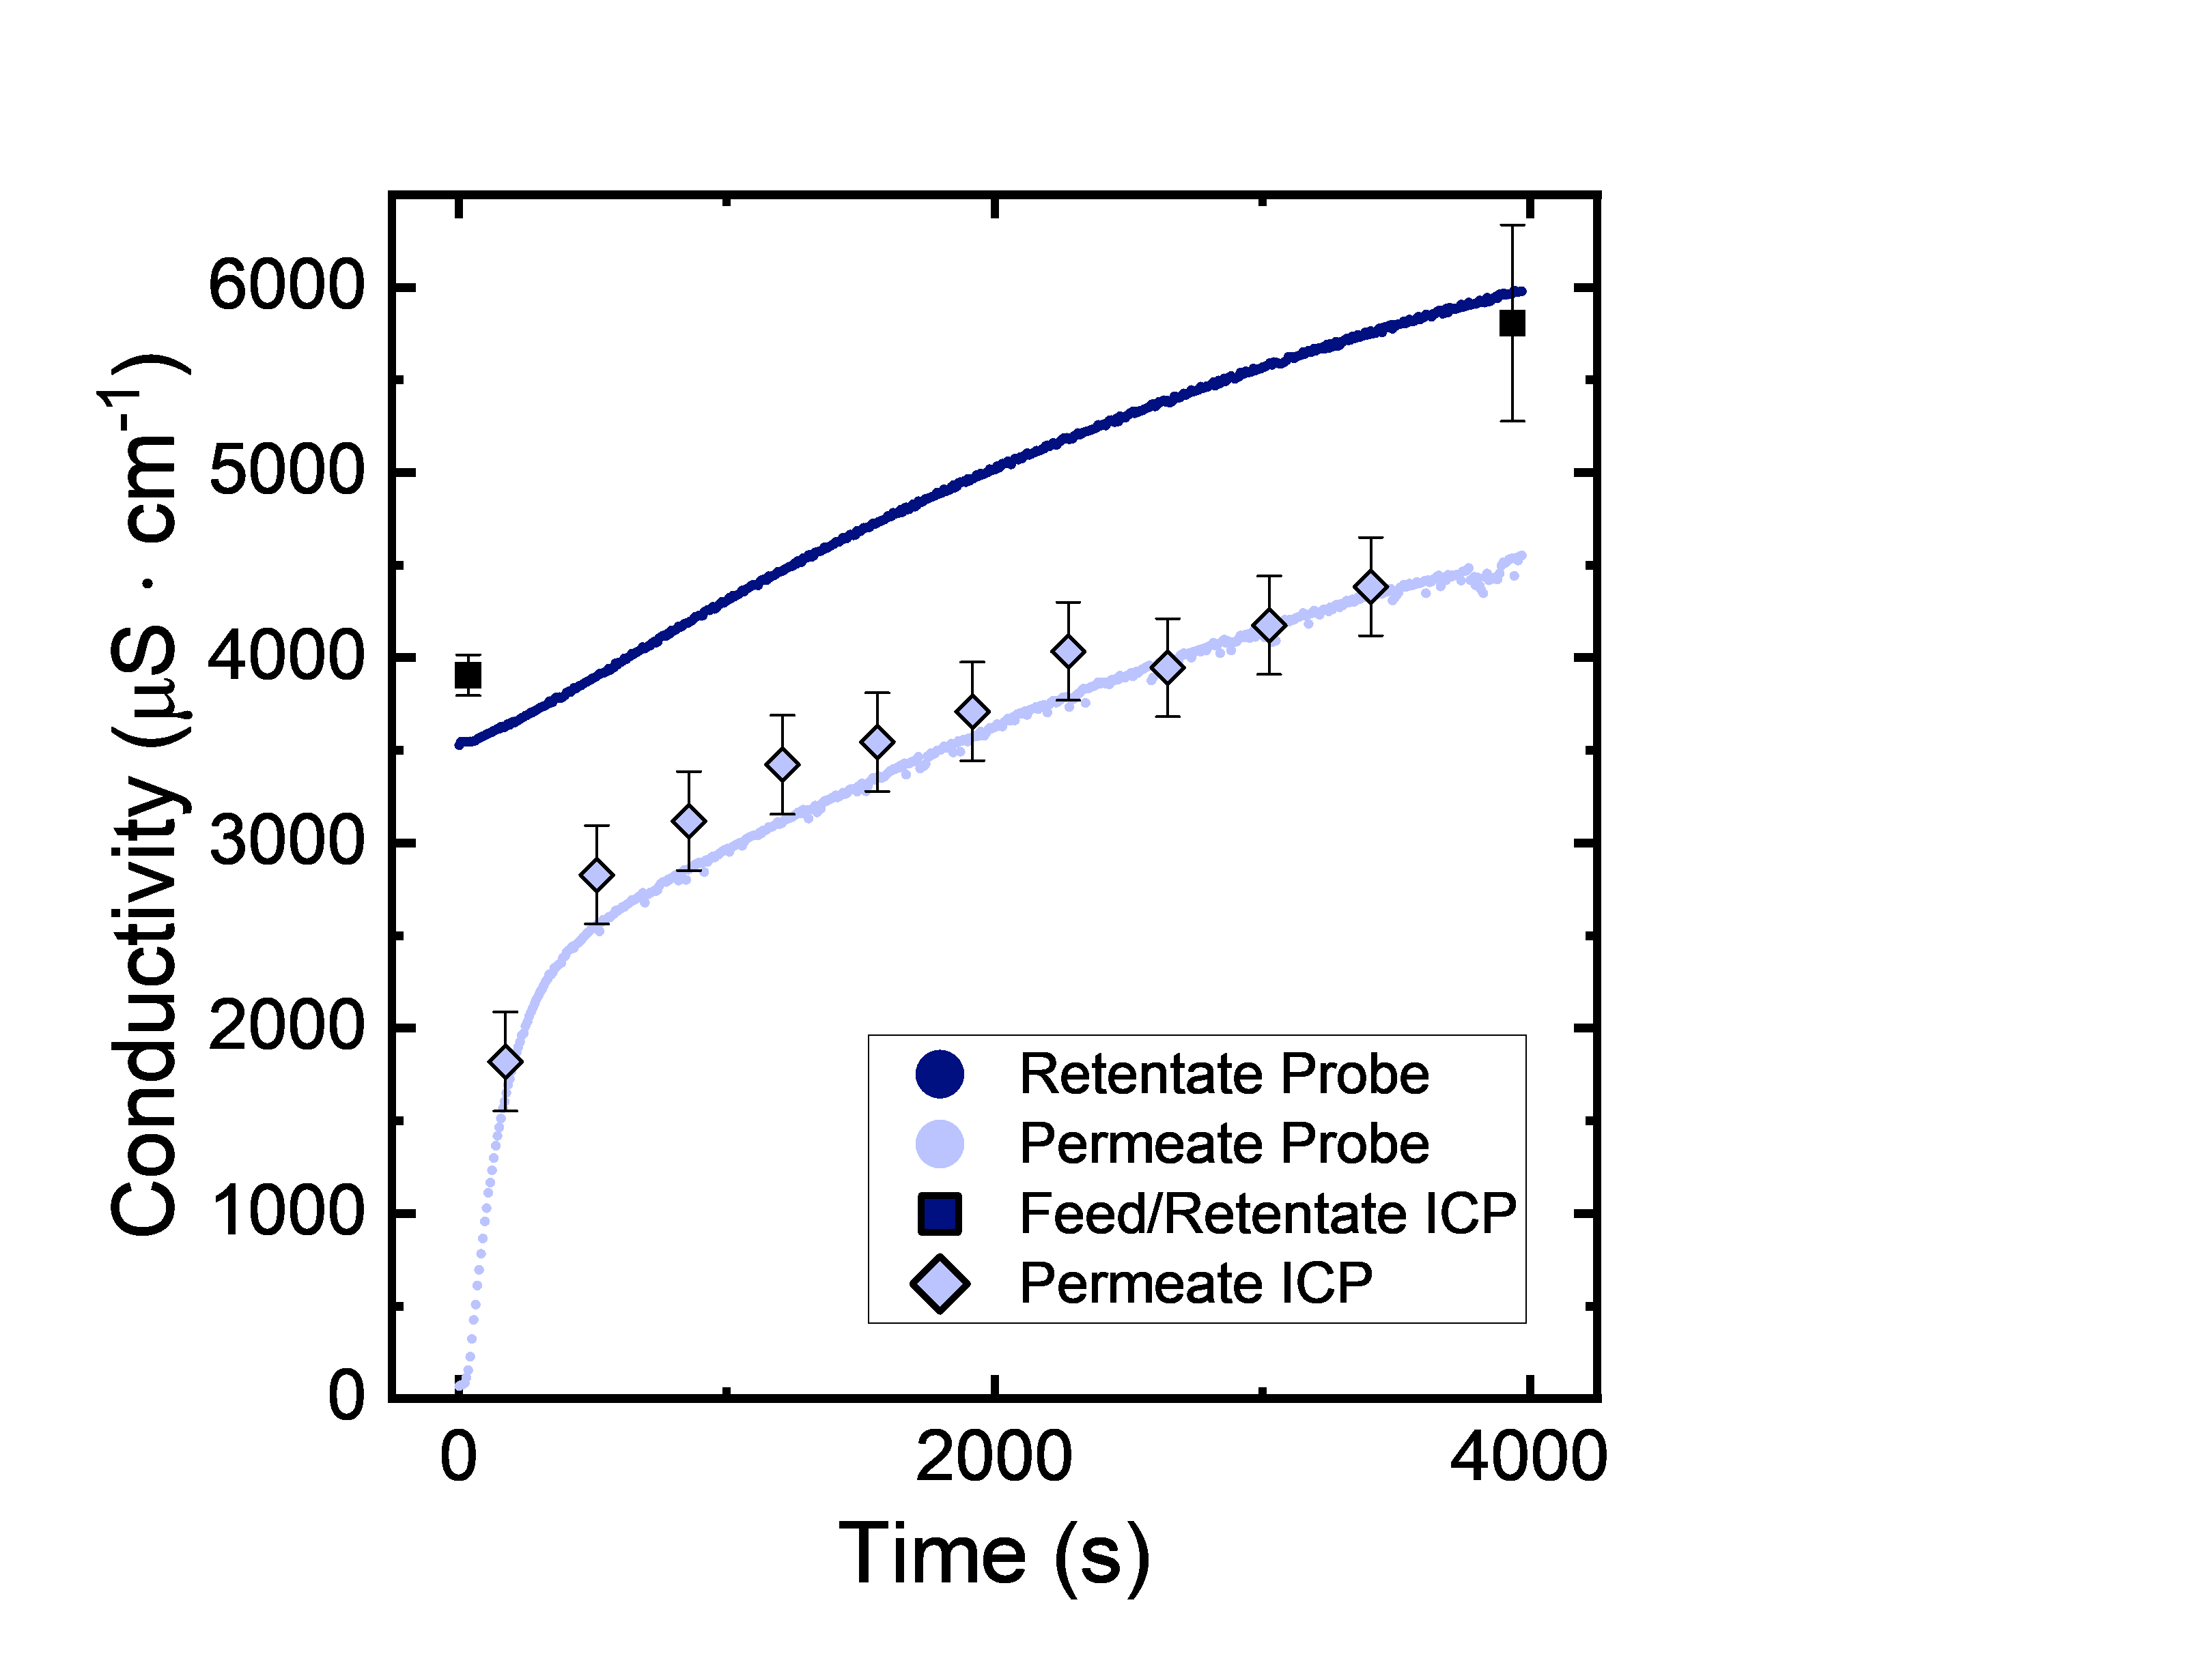
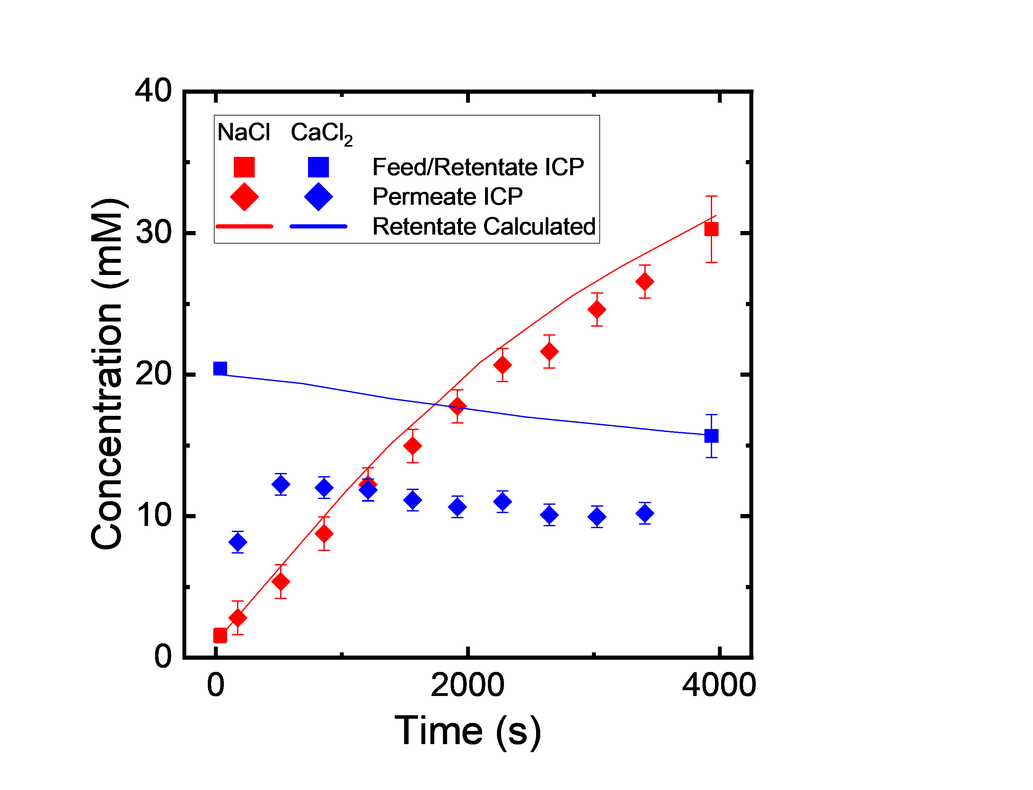
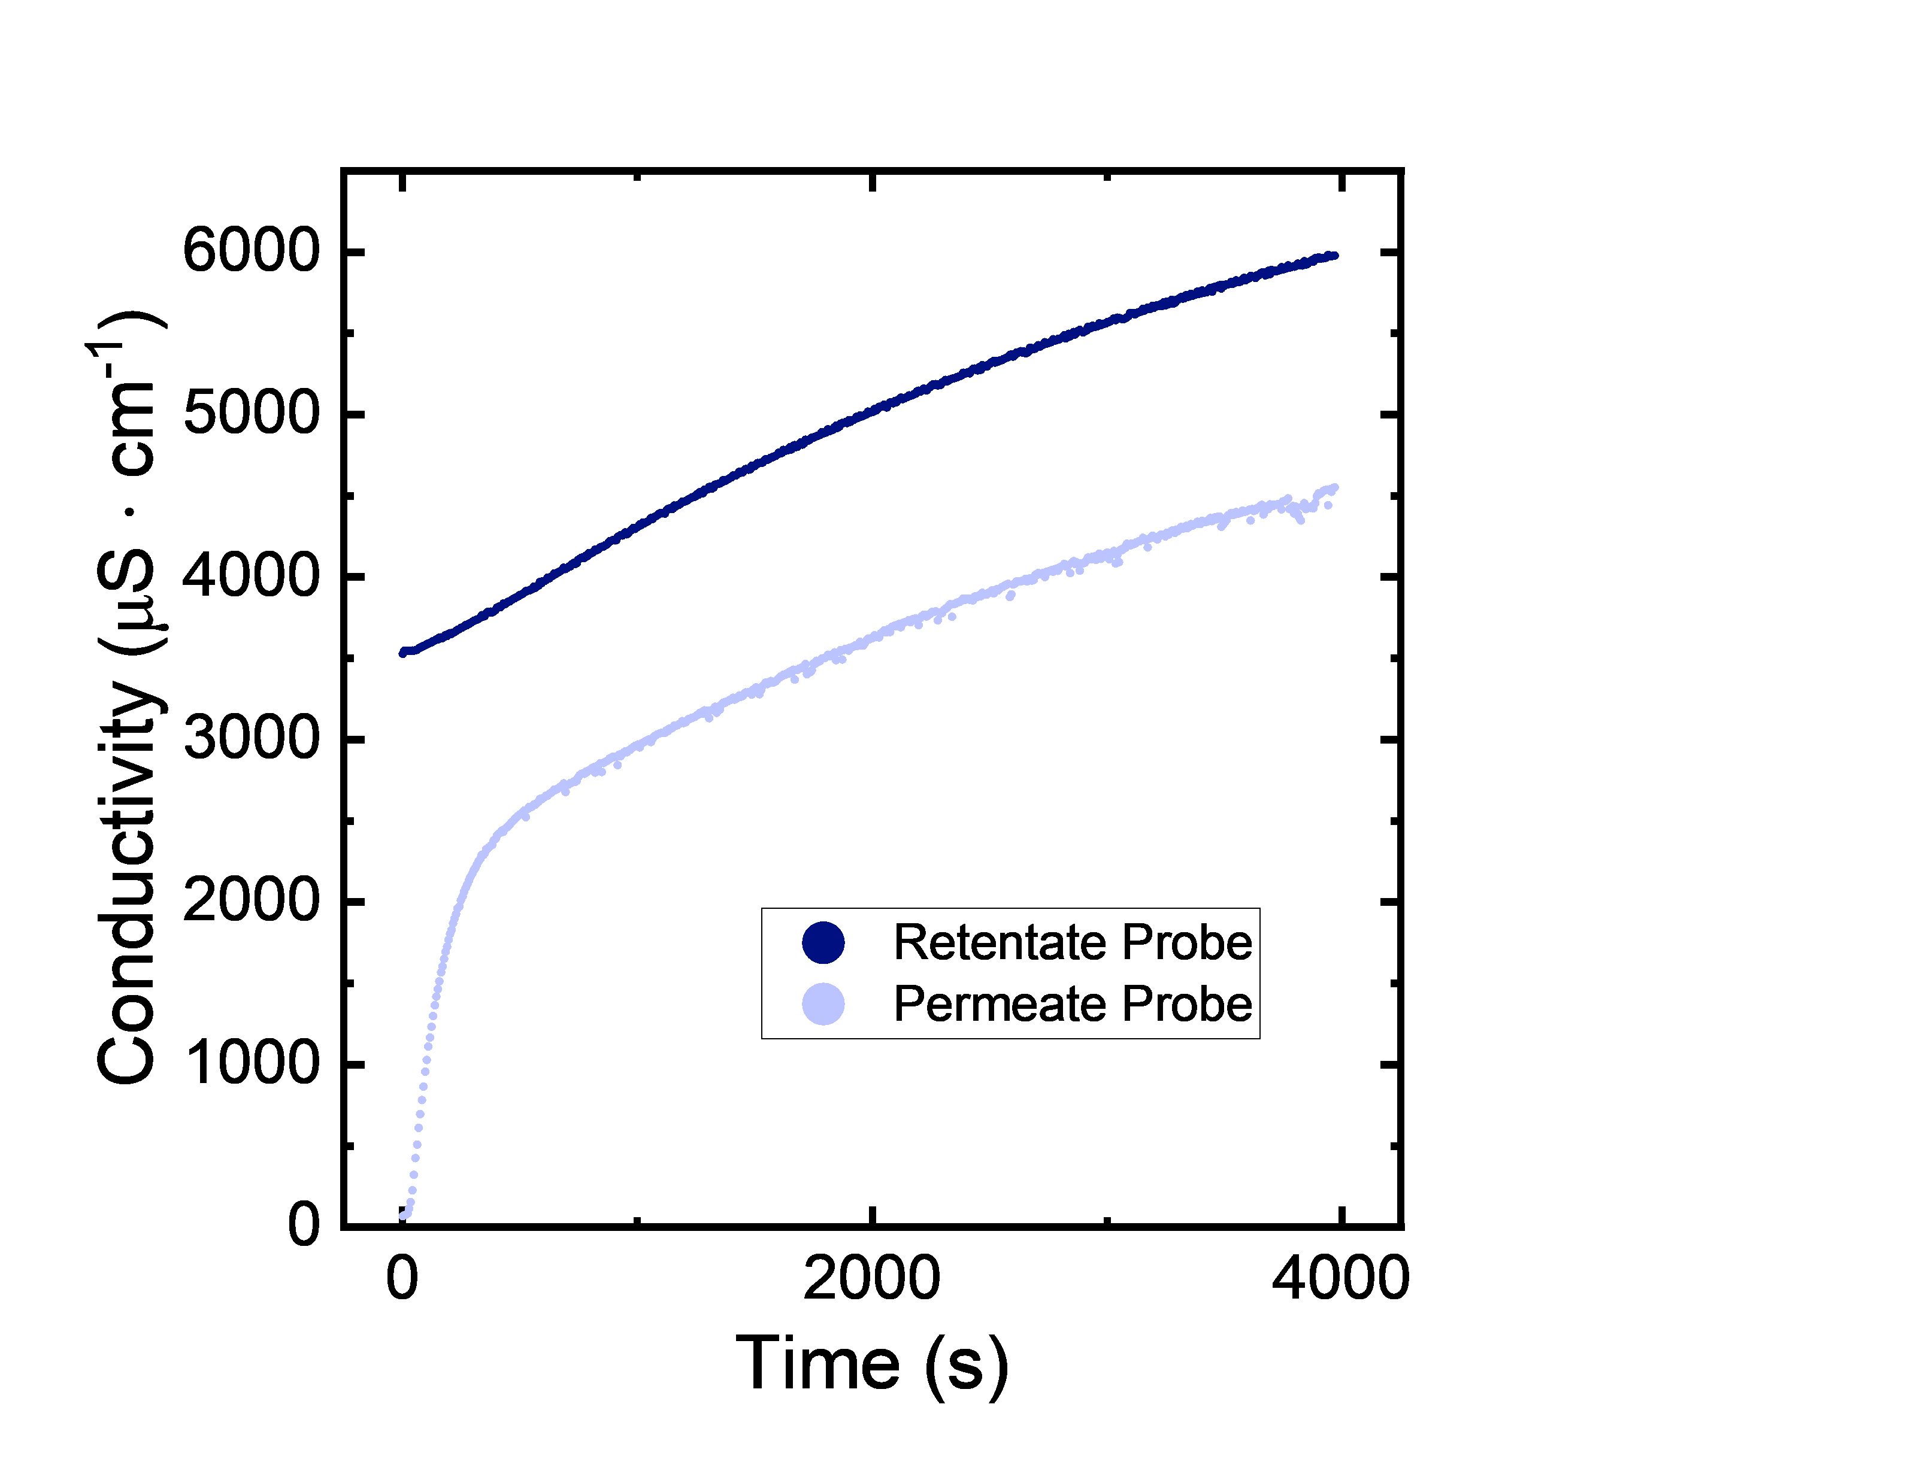
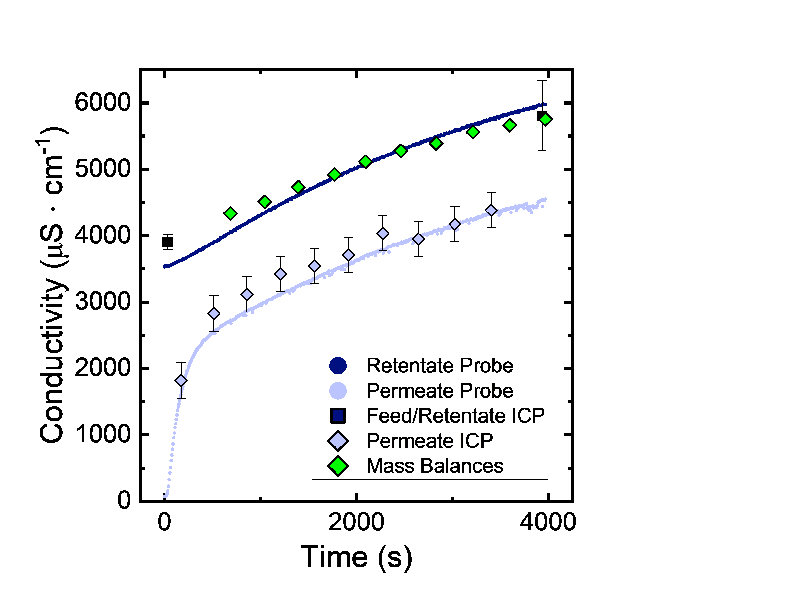
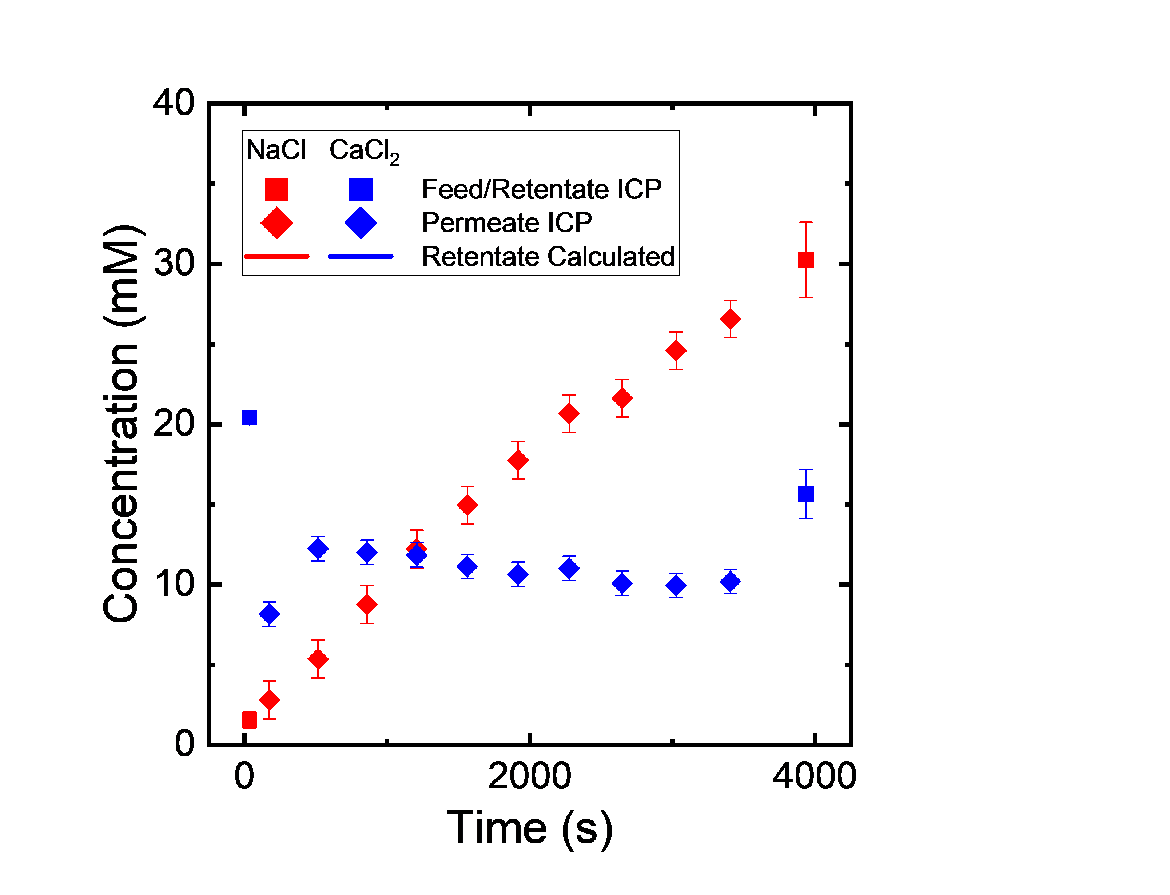
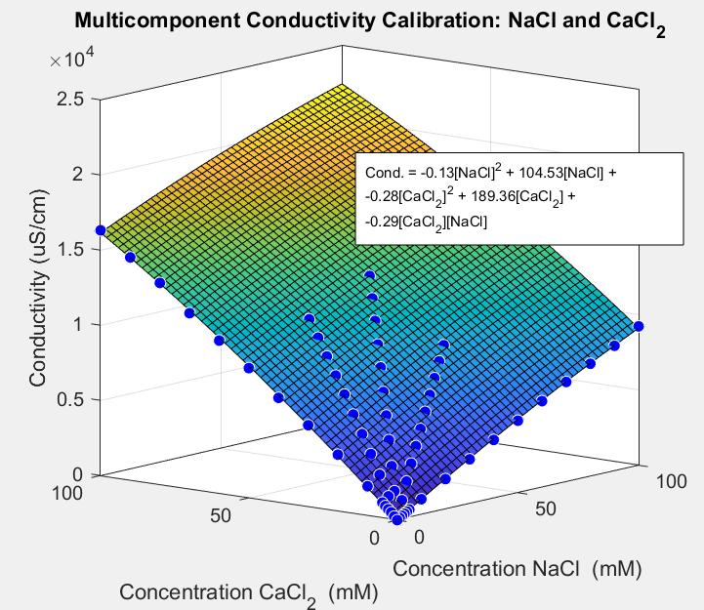
Data Analysis and Visualization
Feed: 20 mM NaCl
Diafiltrate: 10 mM NaCl, 50 mM CaCl₂

Slide 6
Action Items/Discussion
Single Salt Experiments - Running these will mirror Xinhong’s work for the “Permeate Probe” and “NF270” Manuscripts.
Who in the Dowling lab is running these to regress variables?
Do we have a code that is functional for single component data analysis
That simultaneously regresses parameters using (1) retentate and permeate conductivity probes, (2) ICP data, (3) mass data
What is the timeline to get the single salt experiments rigorously analyzed through the codes?
Regression of H, D, Lp, σ, identification of which salts possess concentration dependent parameters?
Let’s email to set up a meeting offline.
Multicomponent Experiments
Analysis was limited by my derivation of multicomponent equations.

Slide 7
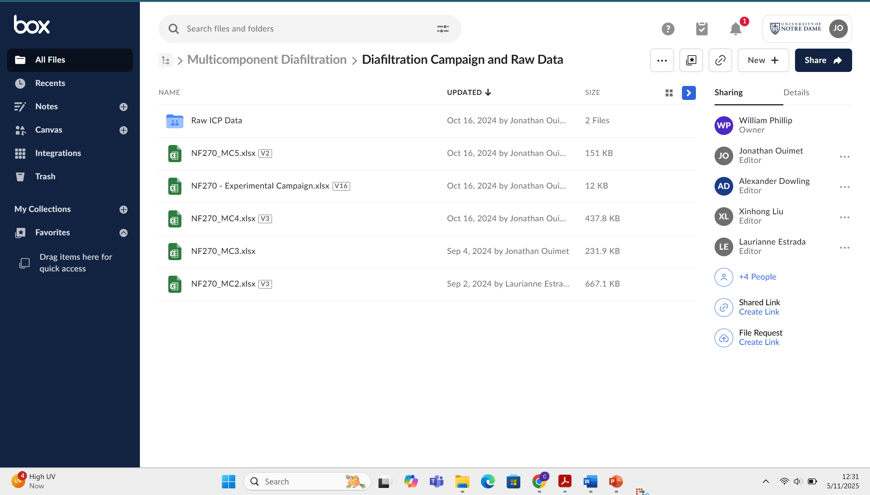
Request/Need: Everything needs to be in BOX for me to follow along.
Over 28 experiments have been conducted to characterize multicomponent effects.
Single Salt Experiments: 13 Experiments (7 NaCl, 4 CaCl2, 2 LaCl3)
Two Salt Experiments: 15 Experiments

Slide 8
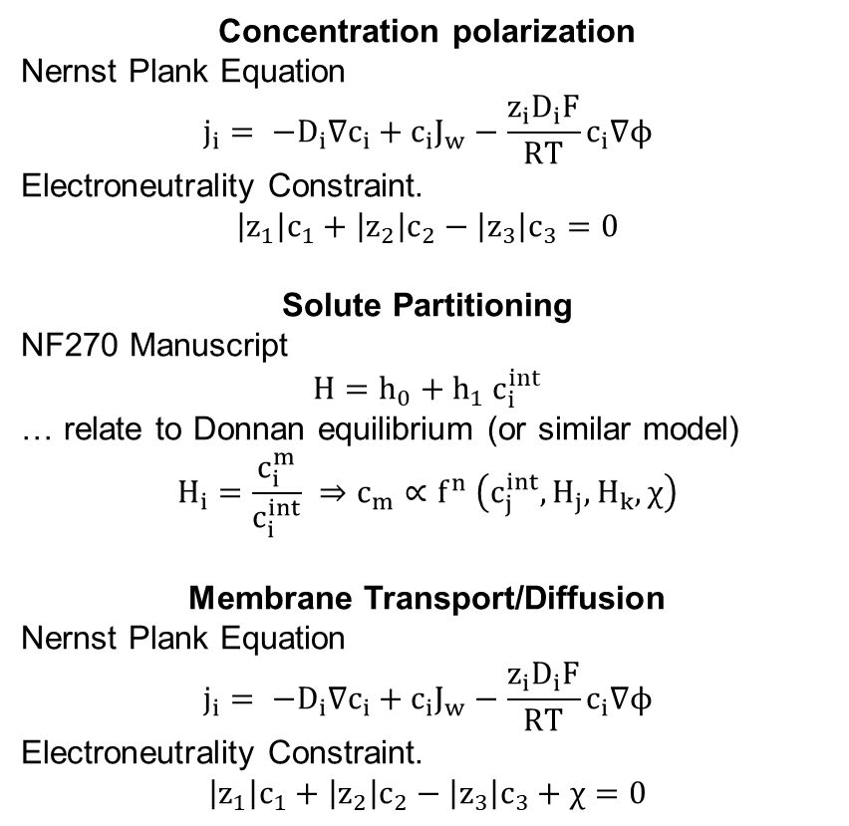
Physical picture of modeling efforts.
Concentration polarization
Nernst Plank Equation
$$j_{i}= −D_{i}∇c_{i}+c_{i}J_{w}−\frac{z_{i}D_{i}F}{RT}c_{i}∇ϕ$$
Electroneutrality Constraint.
$$\left|z_{1}\right|c_{1}+\left|z_{2}\right|c_{2}−\left|z_{3}\right|c_{3}=0$$
Solute Partitioning
NF270 Manuscript
$$H=h_{0}+h_{1} c_{i}^{int}$$
… relate to Donnan equilibrium (or similar model)
$$H_{i}=\frac{c_{i}^{m}}{c_{i}^{int}} ⇒c_{m}∝f^{n} \left(c_{j}^{int}, H_{j}, H_{k}, χ\right)$$
Membrane Transport/Diffusion
Nernst Plank Equation
$$j_{i}= −D_{i}∇c_{i}+c_{i}J_{w}−\frac{z_{i}D_{i}F}{RT}c_{i}∇ϕ$$
Electroneutrality Constraint.
$$\left|z_{1}\right|c_{1}+\left|z_{2}\right|c_{2}−\left|z_{3}\right|c_{3}+χ=0$$
Partitioning
Concentration Polarization
Membrane Transport/Diffusion
Feed
Membrane
Permeate
$$j_{i}^{feed}=j_{i}^{membrane}=j_{i}^{permeate}$$

Slide 9
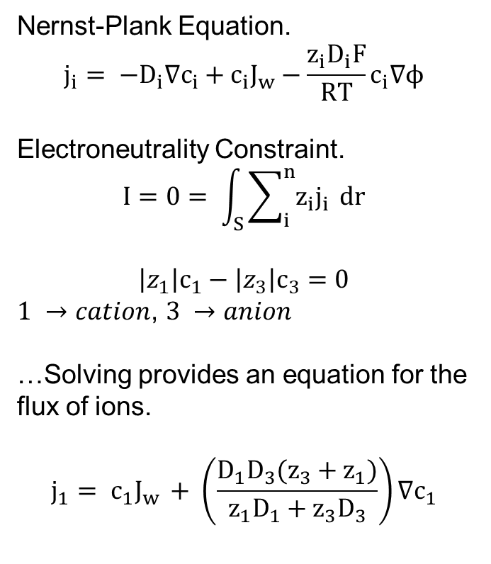
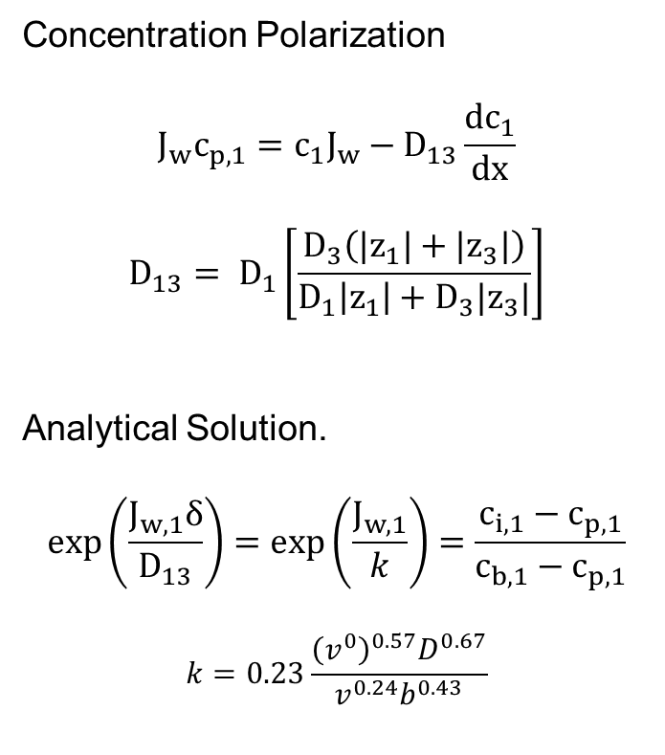
Equations for the flux of species in solution.
Derived from Nernst-Plank equation, two species in solution.
Nernst-Plank Equation.
$$j_{i}= −D_{i}∇c_{i}+c_{i}J_{w}−\frac{z_{i}D_{i}F}{RT}c_{i}∇ϕ$$
Electroneutrality Constraint.
$$I=0= \int_{S}{\sum_{i}^{n}{z_{i}j_{i}} dr}$$
$$\left|z_{1}\right|c_{1}−\left|z_{3}\right|c_{3}=0$$
$1 →cation$, $3 →anion$
…Solving provides an equation for the flux of ions.
$$j_{1}= c_{1}J_{w }+ \left(\frac{{D_{1}D}_{3}(z_{3}+z_{1})}{z_{1}D_{1}+z_{3}D_{3}}\right)∇c_{1}$$
Concentration Polarization
$$J_{w}c_{p,1}=c_{1}J_{w}−D_{13}\frac{dc_{1}}{dx}$$
$$D_{13}= D_{1}\left[\frac{D_{3}\left({|z}_{1}|+{|z}_{3}|\right)}{D_{1}\left|z_{1}\right|+D_{3}|z_{3}|}\right]$$
Analytical Solution.
$$\exp\left(\frac{J_{w,1}δ}{D_{13}}\right)=\exp\left(\frac{J_{w,1}}{k}\right)=\frac{c_{i,1}−c_{p,1}}{c_{b,1}−c_{p,1}}$$
$$k=0.23\frac{{\left(v^{0}\right)}^{0.57}D^{0.67}}{v^{0.24}b^{0.43}}$$

Slide 10
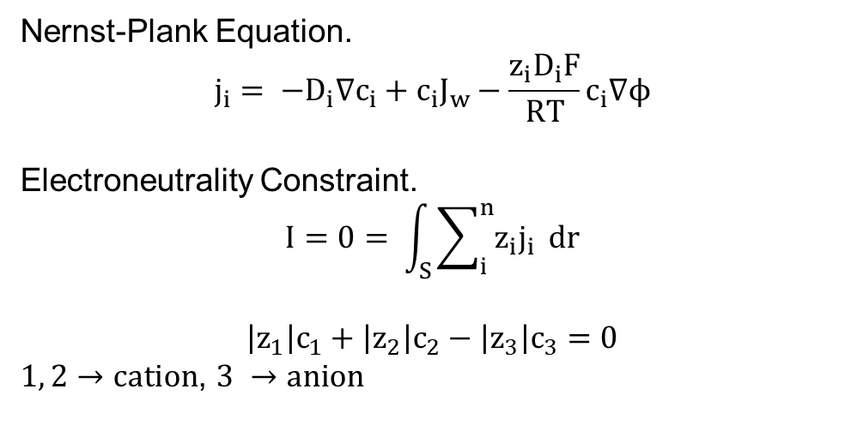
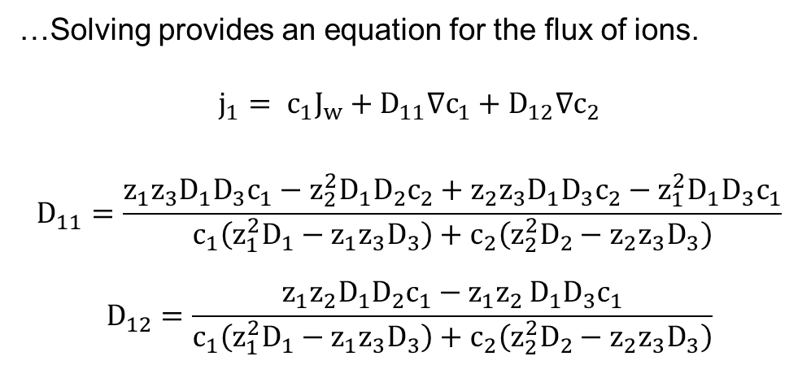
Equations for the flux of species in solution.
Derived from Nernst-Plank equation, three species in solution.
Nernst-Plank Equation.
$$j_{i}= −D_{i}∇c_{i}+c_{i}J_{w}−\frac{z_{i}D_{i}F}{RT}c_{i}∇ϕ$$
Electroneutrality Constraint.
$$I=0= \int_{S}{\sum_{i}^{n}{z_{i}j_{i}} dr}$$
$$\left|z_{1}\right|c_{1}+\left|z_{2}\right|c_{2}−\left|z_{3}\right|c_{3}=0$$
$1, 2→cation$, $3 →anion$
…Solving provides an equation for the flux of ions.
$$j_{1}= c_{1}J_{w}+D_{11}∇c_{1}+D_{12}∇c_{2}$$
$$D_{11}=\frac{z_{1}{z_{3}D_{1}D}_{3}c_{1}−z_{2}^{2}{D_{1}D}_{2}c_{2}+z_{2}{z_{3}D_{1}D}_{3}c_{2}−{z_{1}^{2}D_{1}D}_{3}c_{1}}{c_{1}\left(z_{1}^{2}D_{1}−z_{1}{z_{3}D}_{3}\right)+c_{2}\left(z_{2}^{2}D_{2}−z_{2}{z_{3}D}_{3}\right)}$$
$$D_{12}=\frac{{z_{1}z_{2}D_{1}D}_{2}c_{1}−{z_{1}{z_{2 }D}_{1}D}_{3}c_{1}}{c_{1}\left(z_{1}^{2}D_{1}−z_{1}{z_{3}D}_{3}\right)+c_{2}\left(z_{2}^{2}D_{2}−z_{2}{z_{3}D}_{3}\right)}$$
Be cautious about negative and positive signs. Please check derivation to ensure accuracy.

Slide 11
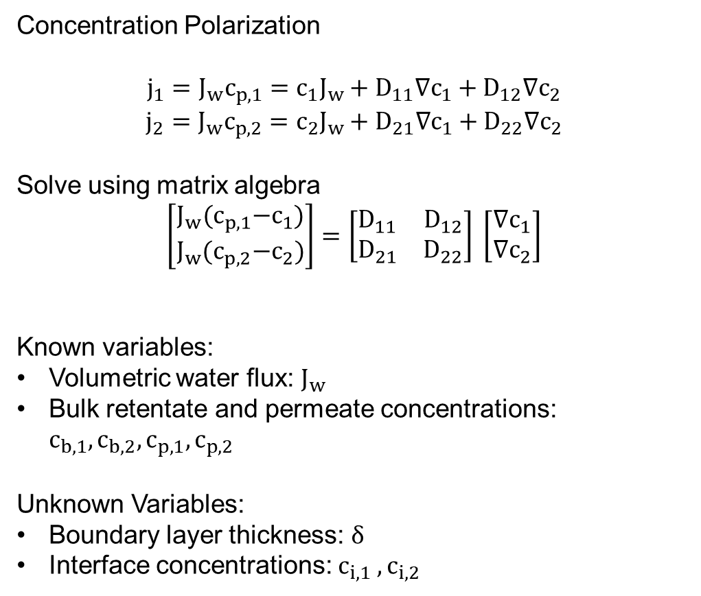
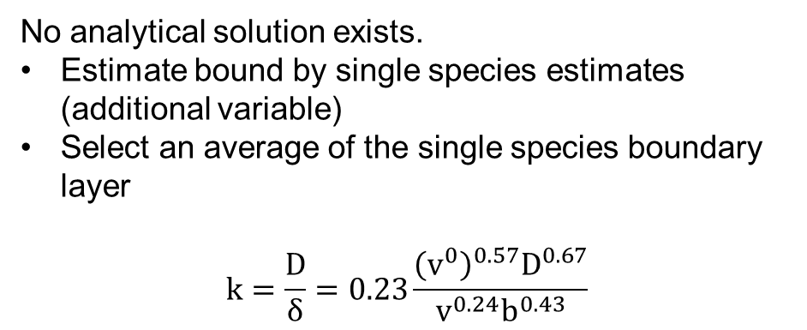
Equations for the flux of species in solution.
Derived from Nernst-Plank equation, three species in solution.
Concentration Polarization
$$j_{1}=J_{w}c_{p,1}=c_{1}J_{w}+D_{11}∇c_{1}+D_{12}∇c_{2}$$
$$j_{2}=J_{w}c_{p,2}=c_{2}J_{w}+D_{21}∇c_{1}+D_{22}∇c_{2}$$
Solve using matrix algebra
$$\left[\begin{matrix}J_{w}{(c}_{p,1}−c_{1}) \\ J_{w}{(c}_{p,2}−c_{2})\end{matrix}\right]=\left[\begin{matrix}D_{11} & D_{12} \\ D_{21} & D_{22}\end{matrix}\right] \left[\begin{matrix}∇c_{1} \\ ∇c_{2}\end{matrix}\right]$$
Known variables:
Volumetric water flux: $J_{w}$
Bulk retentate and permeate concentrations: $c_{b,1}, c_{b,2}, c_{p,1}, c_{p,2}$
Unknown Variables:
Boundary layer thickness: $δ$
Interface concentrations: $c_{i,1} , c_{i,2}$
No analytical solution exists.
Estimate bound by single species estimates (additional variable)
Select an average of the single species boundary layer
$$k=\frac{D}{δ}=0.23\frac{{\left(v^{0}\right)}^{0.57}D^{0.67}}{v^{0.24}b^{0.43}}$$
** We can solve the differential equations with the initial conditions.
Be cautious about negative and positive signs. Please check derivation to ensure accuracy.

Slide 12
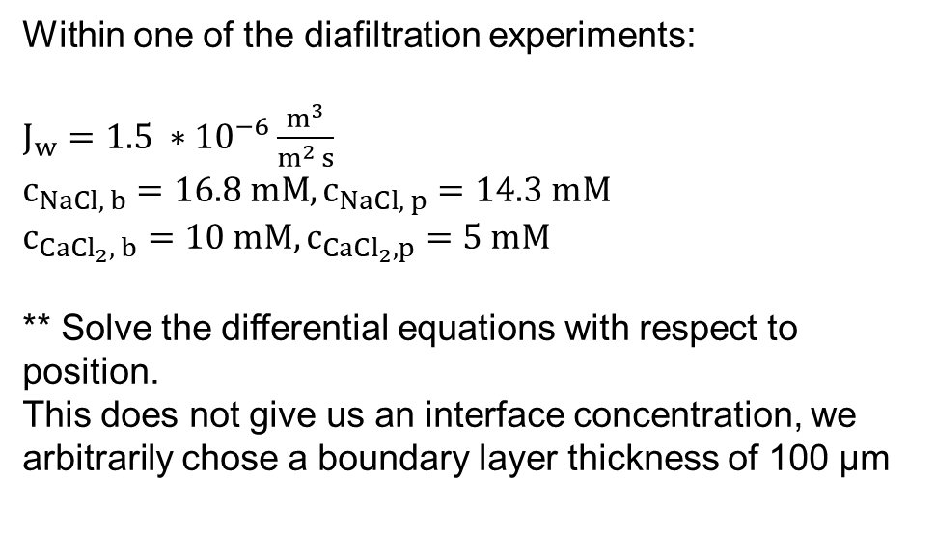
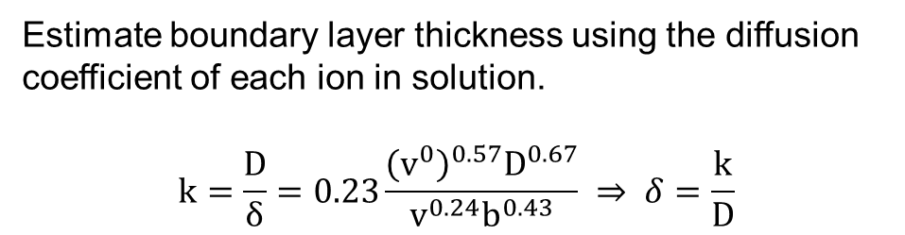
Equations for the flux of species in solution.
Derived from Nernst-Plank equation, three species in solution.
Within one of the diafiltration experiments:
$J_{w}=1.5 ∗{10}^{−6}\frac{m^{3}}{m^{2} s}$
$c_{NaCl, b}=16.8 mM,c_{NaCl, p}=14.3 mM$
$c_{CaCl_{2}, b}=10 mM,c_{CaCl_{2}, p}=5 mM$
** Solve the differential equations with respect to position.
This does not give us an interface concentration, we arbitrarily chose a boundary layer thickness of 100 µm
Estimate boundary layer thickness using the diffusion coefficient of each ion in solution.
$$k=\frac{D}{δ}=0.23\frac{{\left(v^{0}\right)}^{0.57}D^{0.67}}{v^{0.24}b^{0.43}} ⇒ δ=\frac{k}{D}$$

Slide 13
Physical picture of modeling efforts.
Concentration polarization
Nernst Plank Equation
$$j_{i}= −D_{i}∇c_{i}+c_{i}J_{w}−\frac{z_{i}D_{i}F}{RT}c_{i}∇ϕ$$
Electroneutrality Constraint.
$$\left|z_{1}\right|c_{1}+\left|z_{2}\right|c_{2}−\left|z_{3}\right|c_{3}=0$$
Solute Partitioning
NF270 Manuscript
$$H=h_{0}+h_{1} c_{i}^{int}$$
… relate to Donnan equilibrium (or similar model)
$$H_{i}=\frac{c_{i}^{m}}{c_{i}^{int}} ⇒c_{m}∝f^{n} \left(c_{j}^{int}, H_{j}, H_{k}, χ\right)$$
Membrane Transport/Diffusion
Nernst Plank Equation
$$j_{i}= −D_{i}∇c_{i}+c_{i}J_{w}−\frac{z_{i}D_{i}F}{RT}c_{i}∇ϕ$$
Electroneutrality Constraint.
$$\left|z_{1}\right|c_{1}+\left|z_{2}\right|c_{2}−\left|z_{3}\right|c_{3}+χ=0$$
Partitioning
Concentration Polarization
Membrane Transport/Diffusion
Feed
Membrane
Permeate
$$j_{i}^{feed}=j_{i}^{membrane}=j_{i}^{permeate}$$

Slide 14
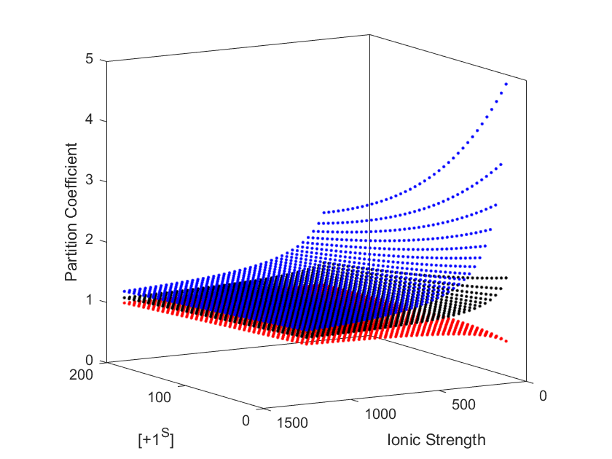
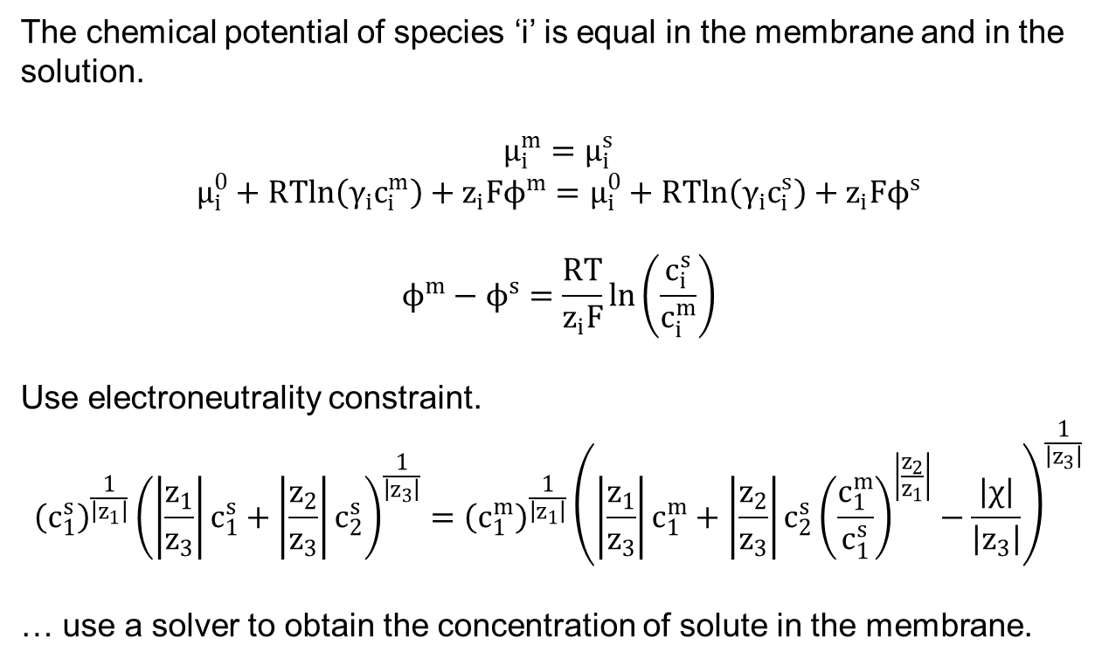
Solute Partitioning: Donnan equilibrium.
The chemical potential of species ‘i’ is equal in the membrane and in the solution.
$$μ_{i}^{m}=μ_{i}^{s}$$
$$μ_{i}^{0}+RTln\left(γ_{i}c_{i}^{m}\right)+z_{i}Fϕ^{m}=μ_{i}^{0}+RTln\left(γ_{i}c_{i}^{s}\right)+z_{i}Fϕ^{s}$$
$$ϕ^{m}−ϕ^{s}=\frac{RT}{z_{i}F}\ln\left(\frac{c_{i}^{s}}{c_{i}^{m}}\right)$$
Use electroneutrality constraint.
$${\left(c_{1}^{s}\right)}^{\frac{1}{\left|z_{1}\right|}}{\left(\left|\frac{z_{1}}{z_{3}}\right|c_{1}^{s}+\left|\frac{z_{2}}{z_{3}}\right|c_{2}^{s}\right)}^{\frac{1}{\left|z_{3}\right|}}={\left(c_{1}^{m}\right)}^{\frac{1}{\left|z_{1}\right|}}{\left(\left|\frac{z_{1}}{z_{3}}\right|c_{1}^{m}+\left|\frac{z_{2}}{z_{3}}\right|c_{2}^{s}{\left(\frac{c_{1}^{m}}{c_{1}^{s}}\right)}^{\left|\frac{z_{2}}{z_{1}}\right|}−\frac{\left|χ\right|}{\left|z_{3}\right|}\right)}^{\frac{1}{\left|z_{3}\right|}}$$
… use a solver to obtain the concentration of solute in the membrane.
Representative of a NaCl/LaCl₃ System
Specie 1: +1
Specie 2: +3
Specie 3: -1

Slide 15
Physical picture of modeling efforts.
Concentration polarization
Nernst Plank Equation
$$j_{i}= −D_{i}∇c_{i}+c_{i}J_{w}−\frac{z_{i}D_{i}F}{RT}c_{i}∇ϕ$$
Electroneutrality Constraint.
$$\left|z_{1}\right|c_{1}+\left|z_{2}\right|c_{2}−\left|z_{3}\right|c_{3}=0$$
Solute Partitioning
NF270 Manuscript
$$H=h_{0}+h_{1} c_{i}^{int}$$
… relate to Donnan equilibrium (or similar model)
$$H_{i}=\frac{c_{i}^{m}}{c_{i}^{int}} ⇒c_{m}∝f^{n} \left(c_{j}^{int}, H_{j}, H_{k}, χ\right)$$
Membrane Transport/Diffusion
Nernst Plank Equation
$$j_{i}= −D_{i}∇c_{i}+c_{i}J_{w}−\frac{z_{i}D_{i}F}{RT}c_{i}∇ϕ$$
Electroneutrality Constraint.
$$\left|z_{1}\right|c_{1}+\left|z_{2}\right|c_{2}−\left|z_{3}\right|c_{3}+χ=0$$
Partitioning
Concentration Polarization
Membrane Transport/Diffusion
Feed
Membrane
Permeate
$$j_{i}^{feed}=j_{i}^{membrane}=j_{i}^{permeate}$$

Slide 16
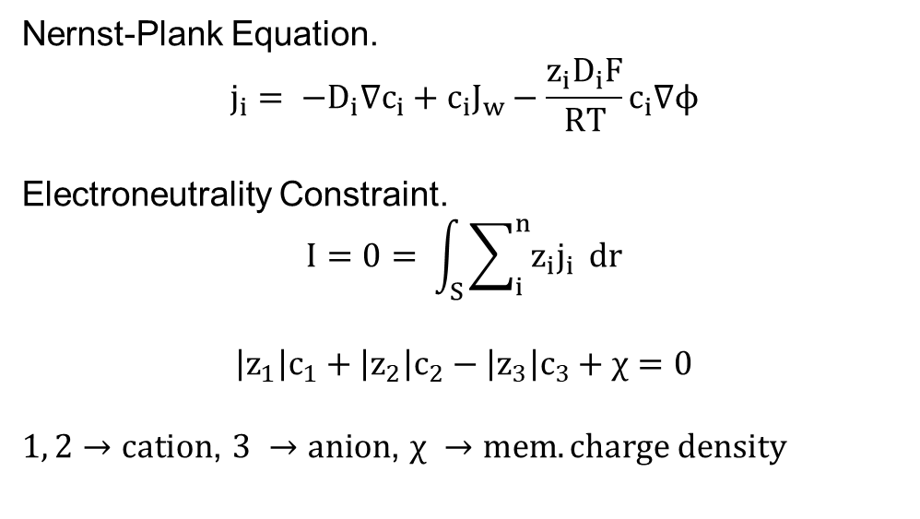
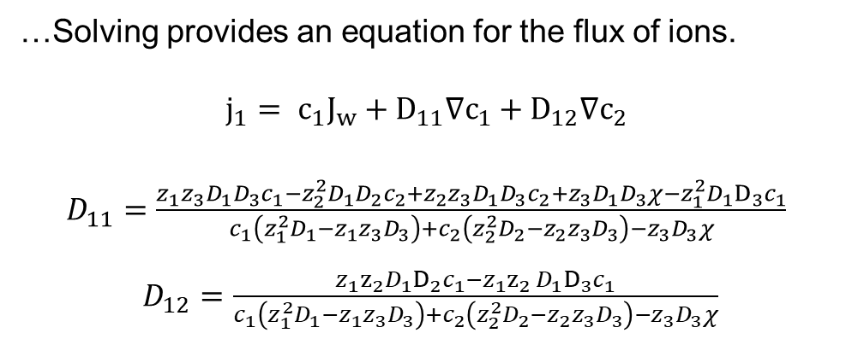
Membrane transport derived for multicomponent transport in membranes.
Nernst-Plank Equation.
$$j_{i}= −D_{i}∇c_{i}+c_{i}J_{w}−\frac{z_{i}D_{i}F}{RT}c_{i}∇ϕ$$
Electroneutrality Constraint.
$$I=0= \int_{S}{\sum_{i}^{n}{z_{i}j_{i}} dr}$$
$$\left|z_{1}\right|c_{1}+\left|z_{2}\right|c_{2}−\left|z_{3}\right|c_{3}+χ=0$$
$1, 2→cation$, $3 →anion$, $χ →mem. charge density$
…Solving provides an equation for the flux of ions.
$$j_{1}= c_{1}J_{w}+D_{11}∇c_{1}+D_{12}∇c_{2}$$
$D_{11}=\frac{z_{1}{z_{3}D_{1}D}_{3}c_{1}−z_{2}^{2}{D_{1}D}_{2}c_{2}+z_{2}{z_{3}D_{1}D}_{3}c_{2}+{z_{3}D_{1}D}_{3}χ−{z_{1}^{2}D_{1}D}_{3}c_{1}}{c_{1}\left(z_{1}^{2}D_{1}−z_{1}{z_{3}D}_{3}\right)+c_{2}\left(z_{2}^{2}D_{2}−z_{2}{z_{3}D}_{3}\right)−{z_{3}D}_{3}χ}$
$D_{12}=\frac{{z_{1}z_{2}D_{1}D}_{2}c_{1}−{z_{1}{z_{2 }D}_{1}D}_{3}c_{1}}{c_{1}\left(z_{1}^{2}D_{1}−z_{1}{z_{3}D}_{3}\right)+c_{2}\left(z_{2}^{2}D_{2}−z_{2}{z_{3}D}_{3}\right)−{z_{3}D}_{3}χ}$

Slide 17
Action Items/Discussion
Single Salt Experiments - Running these will mirror Xinhong’s work for the “Permeate Probe” and “NF270” Manuscripts.
Who in the Dowling lab is running these to regress variables?
Do we have a code that is functional for single component data analysis
That simultaneously regresses parameters using (1) retentate and permeate conductivity probes, (2) ICP data, (3) mass data
What is the timeline to get the single salt experiments rigorously analyzed through the codes?
Regression of H, D, Lp, σ, identification of which salts possess concentration dependent parameters?
Let’s email to set up a meeting offline.
Multicomponent Experiments
Analysis was limited by my derivation of multicomponent equations.
Equations are available online BOX.
Jonathan/Laurianne Action Item: Need to clean up derivation to include in SI.
Once single salt is done, I will reach out to set up a meeting for multicomponent regression.

Slide 18
Supplementary Slides

Slide 19
Manuscript Figures

Slide 20
Figure 1
Pressure Relief Valve
P
Pressure Gauge
Stirred Cell
Scintillation Vials
Diafiltrate Tank
Permeate Outlet
Motor
Retentate Probe
Balance
Membrane
Permeate Probe
Combine Figure 1 and 2?

Slide 21
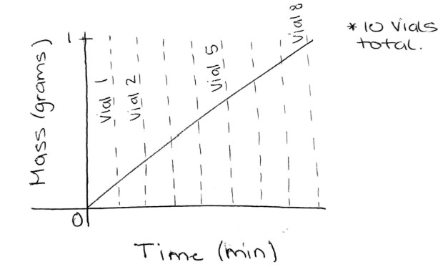
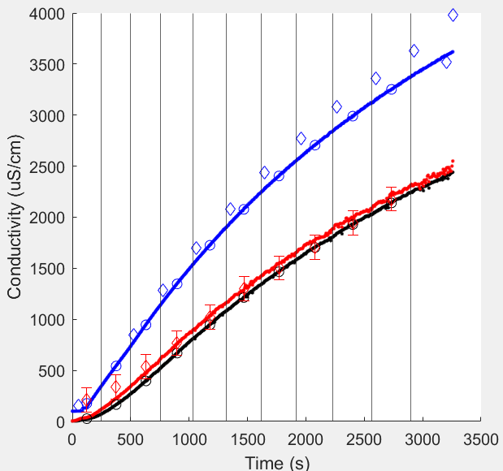
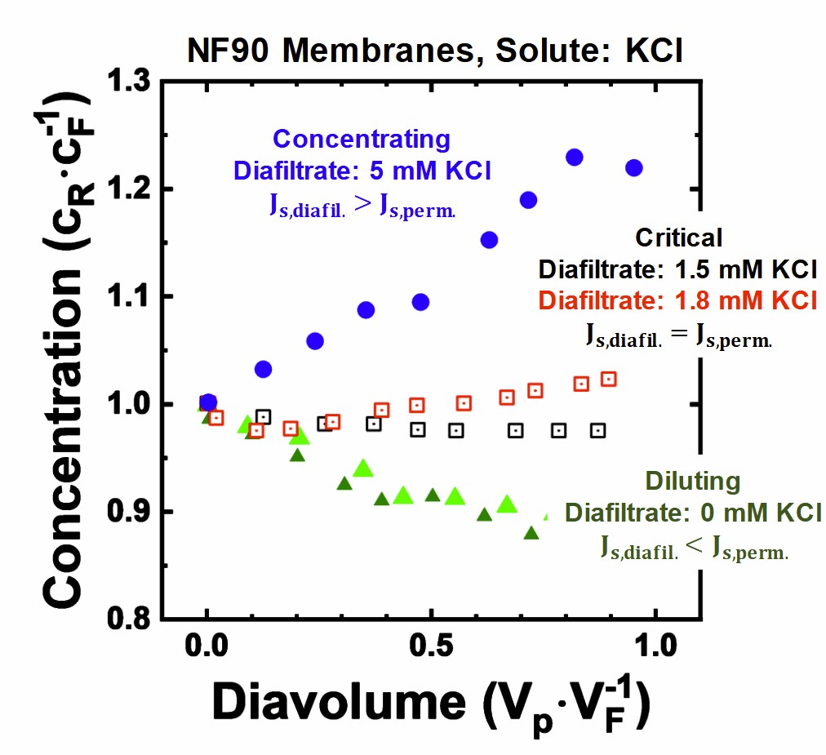
Figure 2
NaCl – Single Component raw data

Slide 22
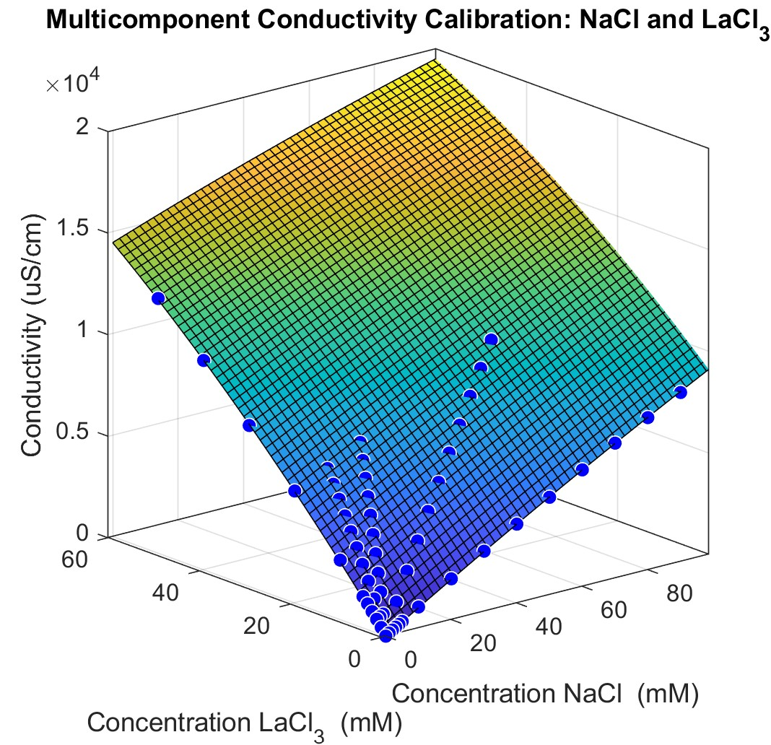
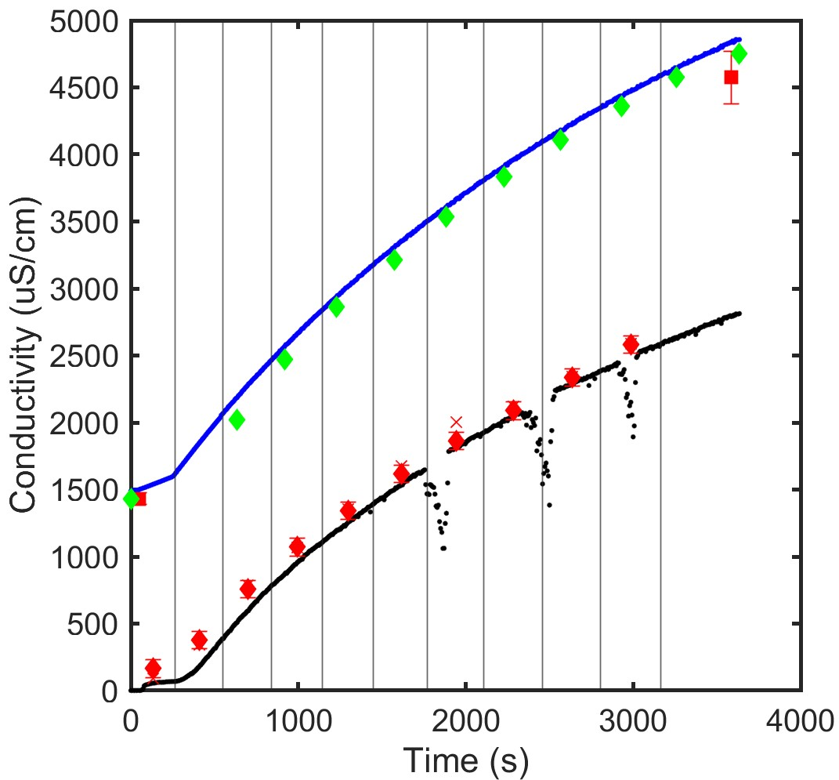
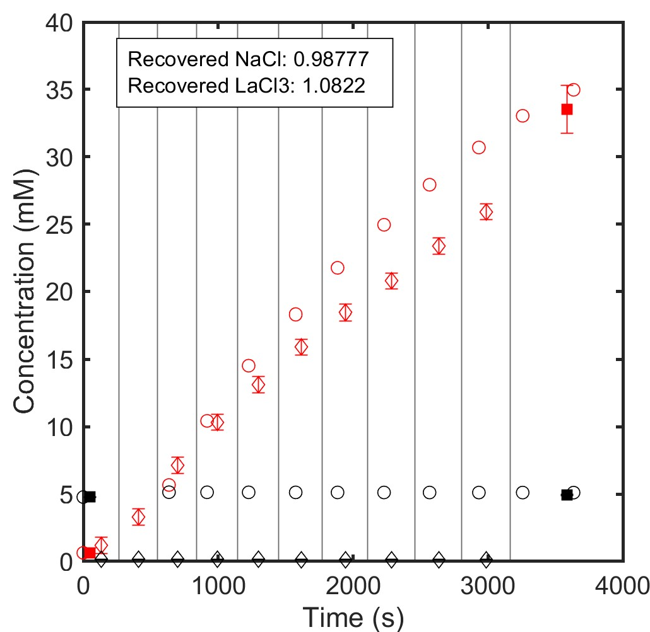
Figure 3
NaCl + LaCl₃ multicomponent raw data
*Main text will show NaCl/LaCl₃. SI plots can be made for NaCl/CaCl₂ and CaCl₂/LaCl₃ multicomponent salts.

Slide 23
Figure 4
Add a circle for the feed concentration (experiment start).
Add a star for the retentate concentration (experiment ends).
Triangles are retentate concentrations that correspond to each permeate vial (calculated from a mass balance using ICP).

Slide 24
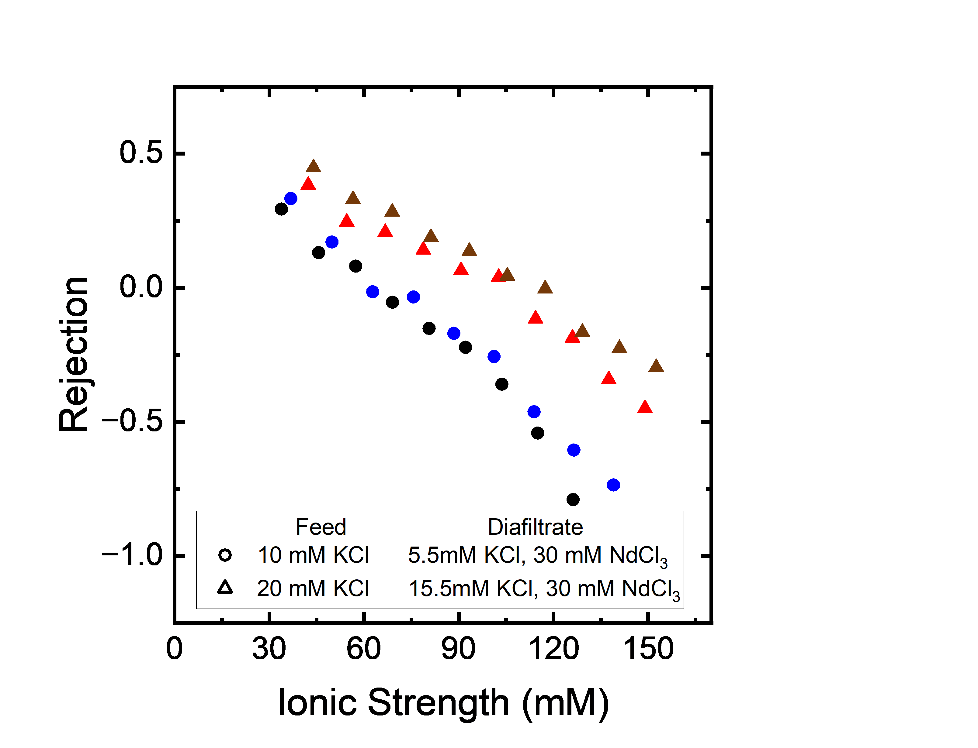
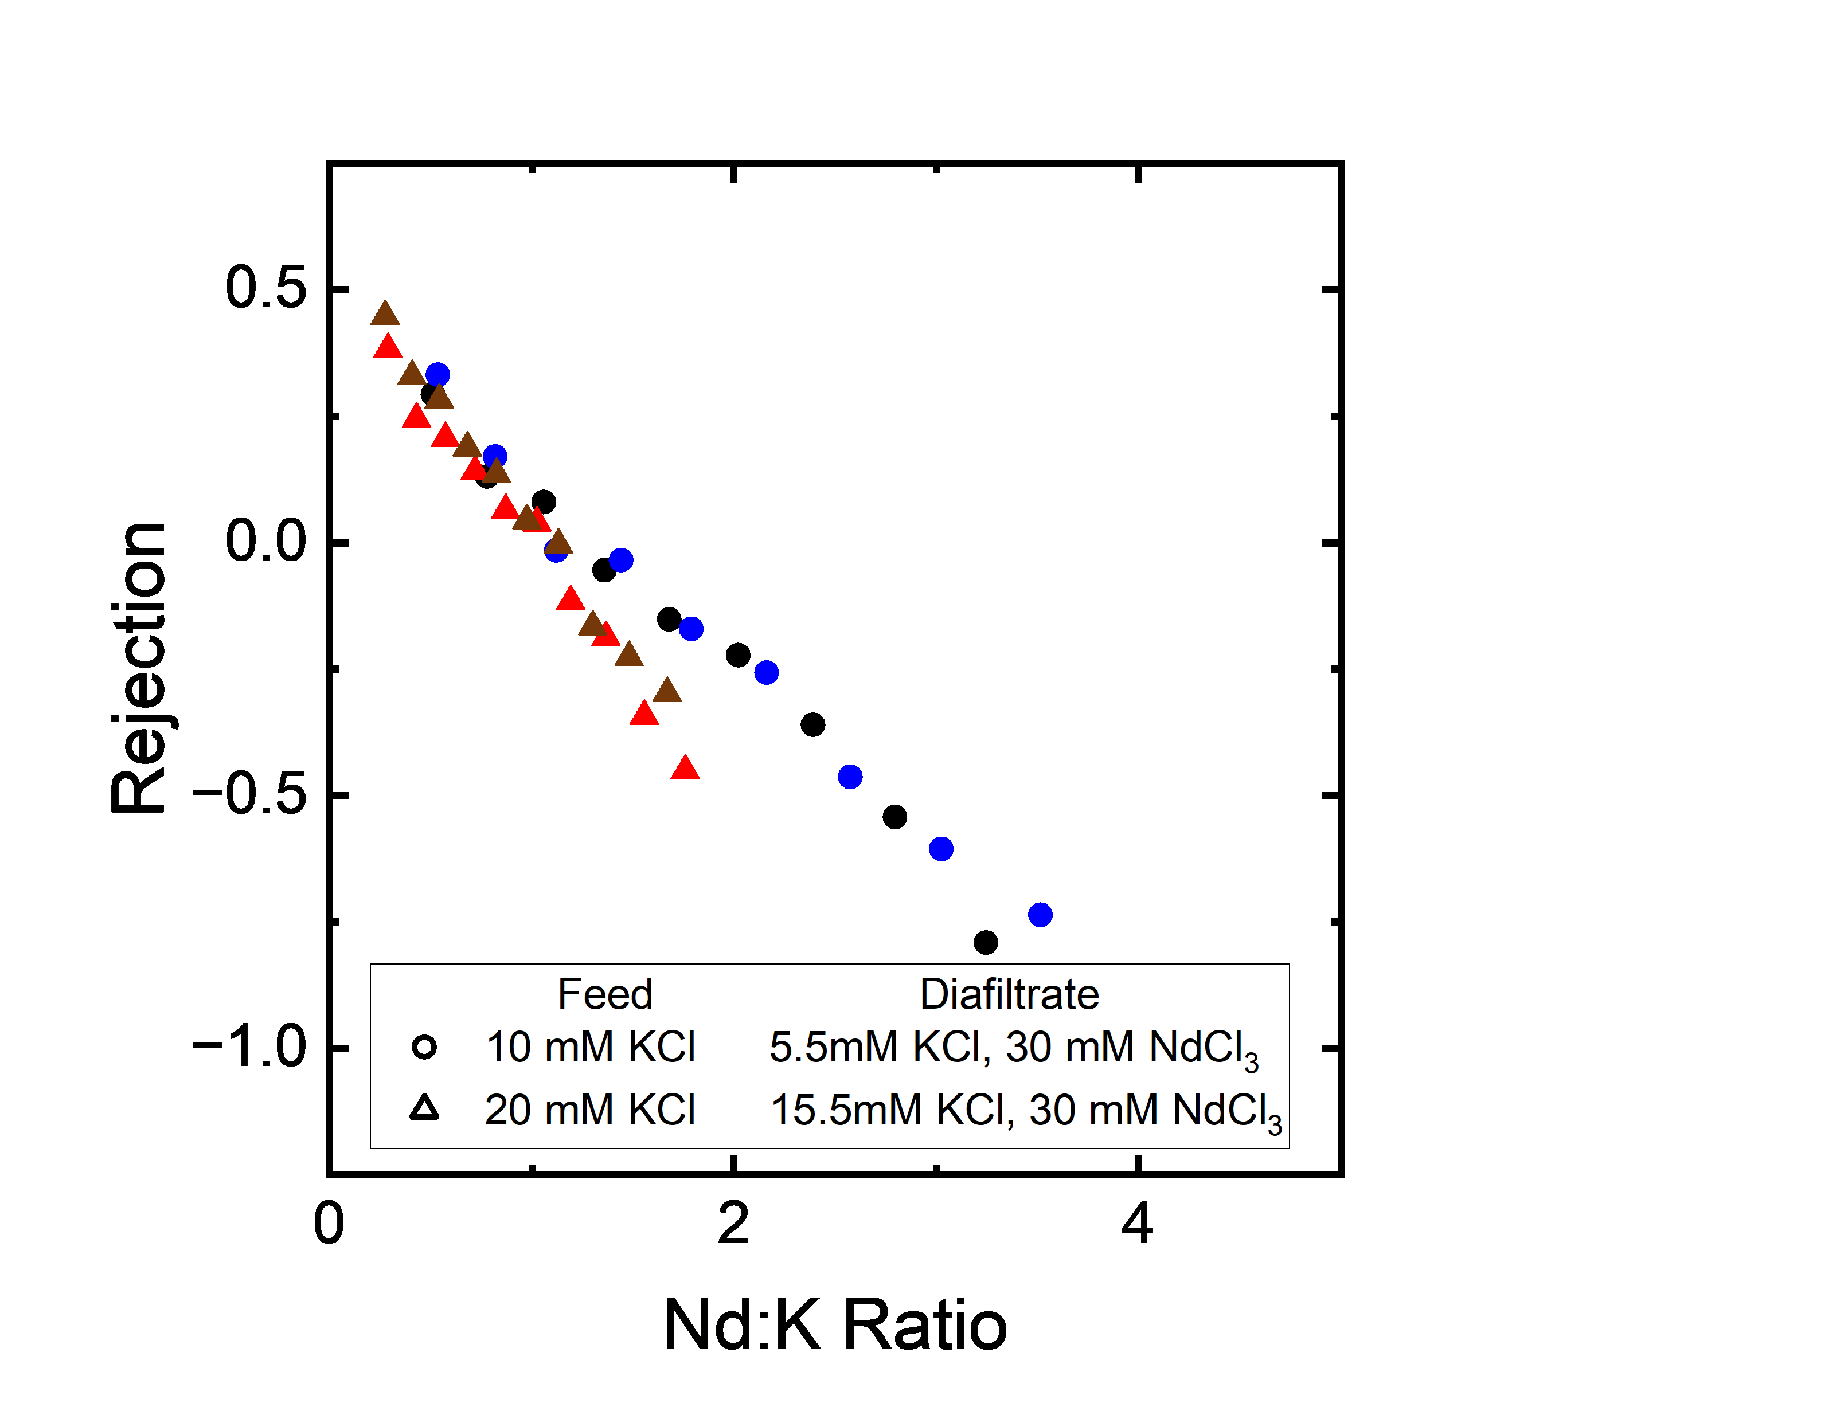
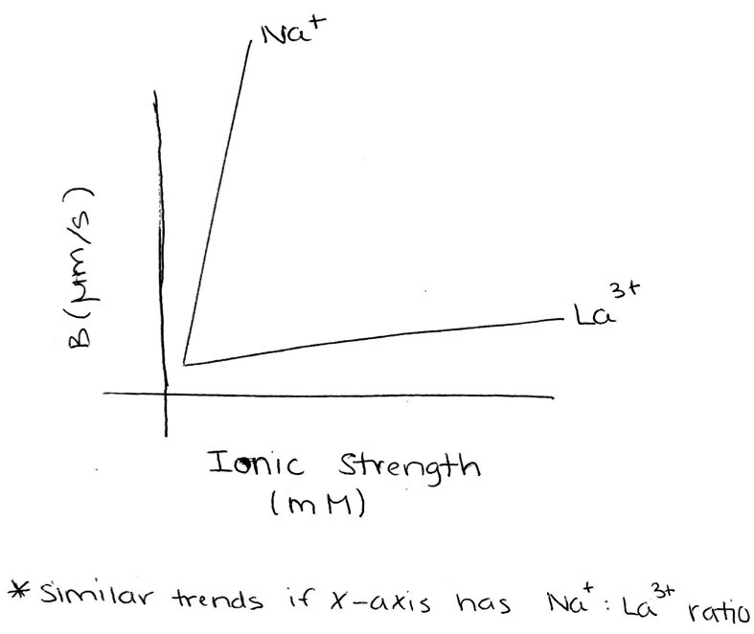
Figure 5

Slide 25
Figure 6
Three ion experiment provided by model-based design of experiments.
Raw diafiltration data
Ion rejections
Selectivity
Material Properties

Slide 26
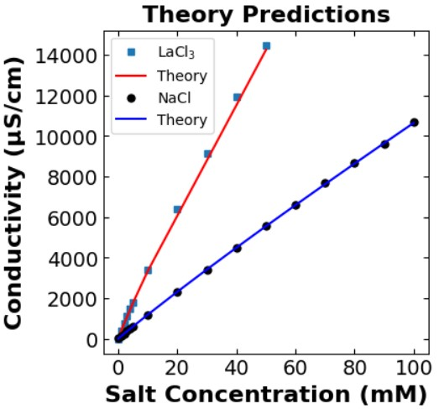
Figure S#

Slide 27
Supplementary Slides

Slide 28
NF270_MC2, E2. Feed: 20 mM CaCl₂, Diafiltrate: 8 mM CaCl₂, 50 mM NaCl
Edits to figure.
Right panel: The current shapes are too similar – suggest having unfilled/half filled diamonds.
Left panel: The green diamonds are ‘confusing’. These are predictions, they should be a line.
SI Table with all the experiments – operating conditions, feed and diafiltrate concentrations, etc.
SI Figures for all experiments conducted to visualize/verify agreement between multiple types of data: Total of 15 – 20 sets of figures. (Duplicate experiments will not have figures)

Slide 29
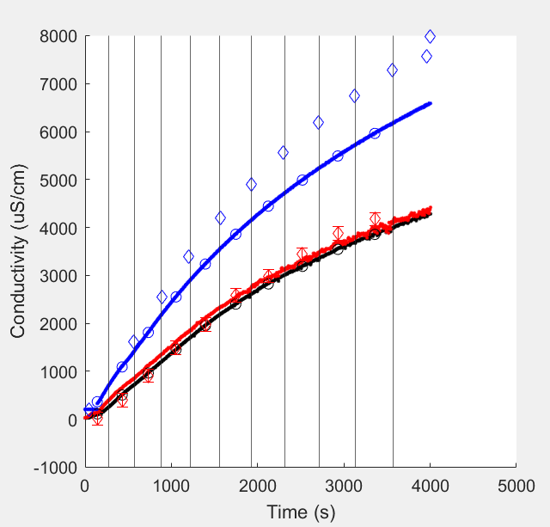
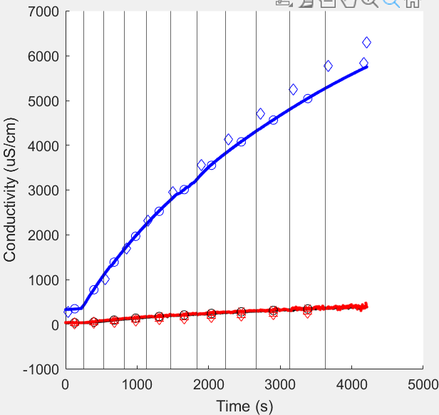
CaCl2 – Single Component
LaCl3 – Single Component

Slide 30
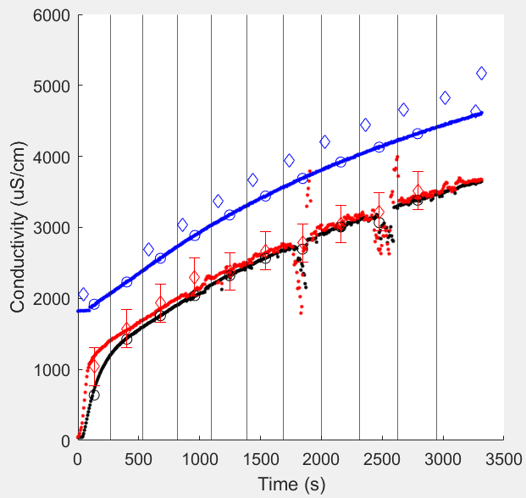
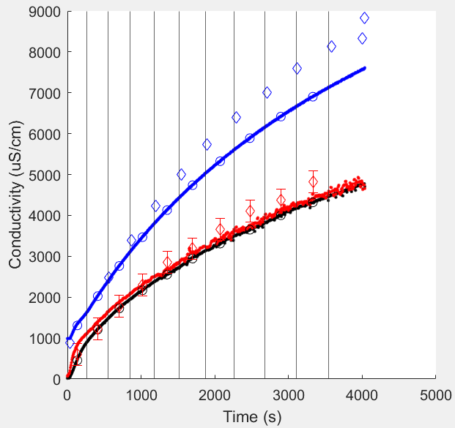
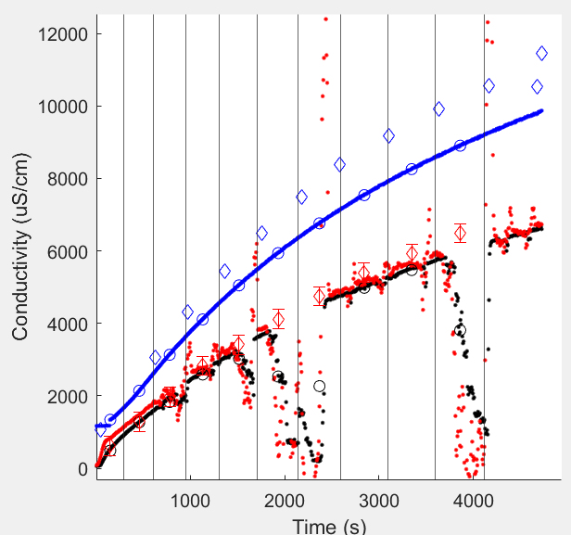
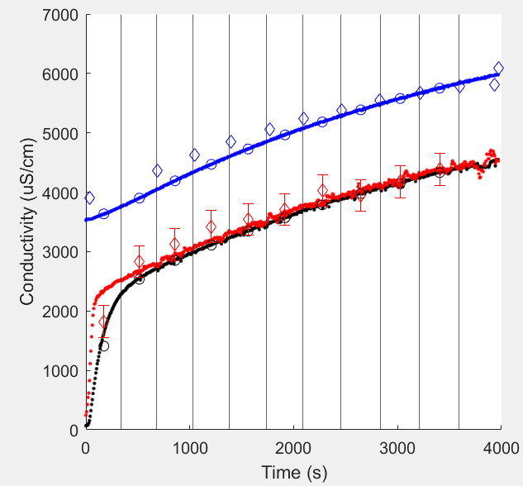
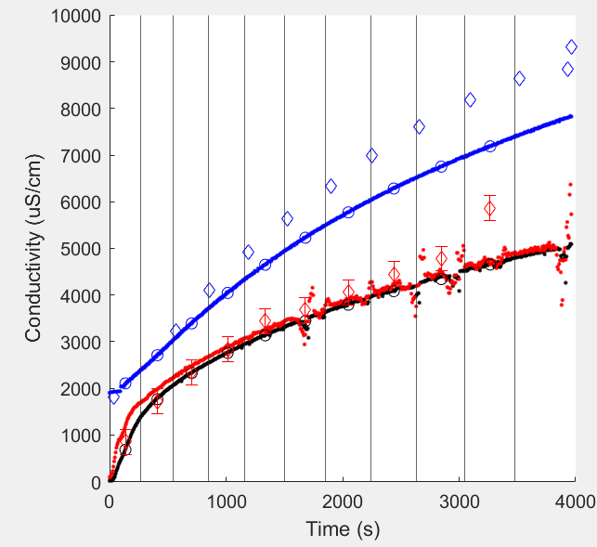
E1.
Feed: 10 mM CaCl2
Diafiltrate: 50 mM NaCl, 4 mM CaCl2
E3.
Feed: 10 mM NaCl
Diafiltrate: 50 mM CaCl2, 5 mM NaCl
E5.
Feed: 10 mM NaCl, 1 mM CaCl2
Diafiltrate: 50 mM CaCl2, 50 mM NaCl
E2.
Feed: 20 mM CaCl2
Diafiltrate: 50 mM NaCl, 8 mM CaCl2
E4.
Feed: 20 mM NaCl
Diafiltrate: 50 mM CaCl2, 10 mM NaCl
NaCl – CaCl2 Multicomponent

